Slide 1
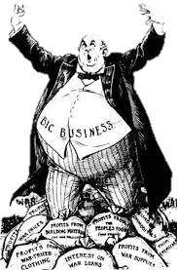
Power of Big Business in the Progressive Era
Ashley, Hannah, Helena, Katie

Slide 2
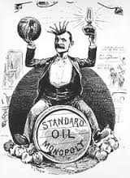
Problems
Large business monopolies suppressed the potential for competition
Companies controlled entire industries and could exploit laborers and consumers
The federal government failed to combat the issue

Slide 3
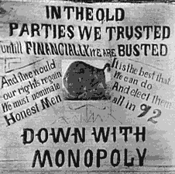
Goals
Regulate large corporations to prevent monopolies
Ensure competition and free enterprise
Establish and enforce antitrust laws

Slide 4
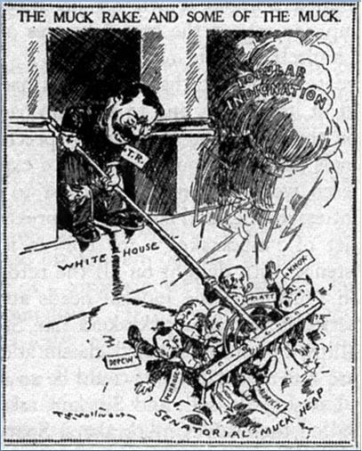
Exposure and Muckraking
Muckrakers worked to expose corruption
Hoped to bring about reform
Exposed the political and economic corruption and social hardships caused by the power of big businesses through detailed and accurate journalism
Corrupted management
Government influence
Monopolies

Slide 5
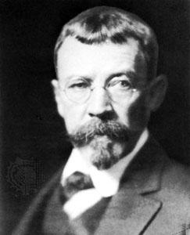
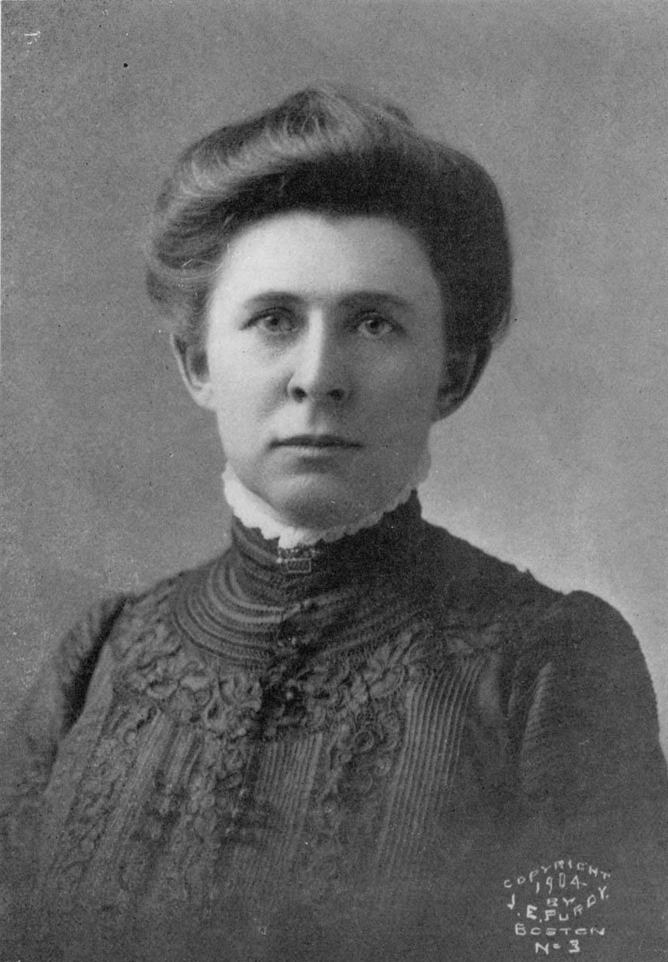
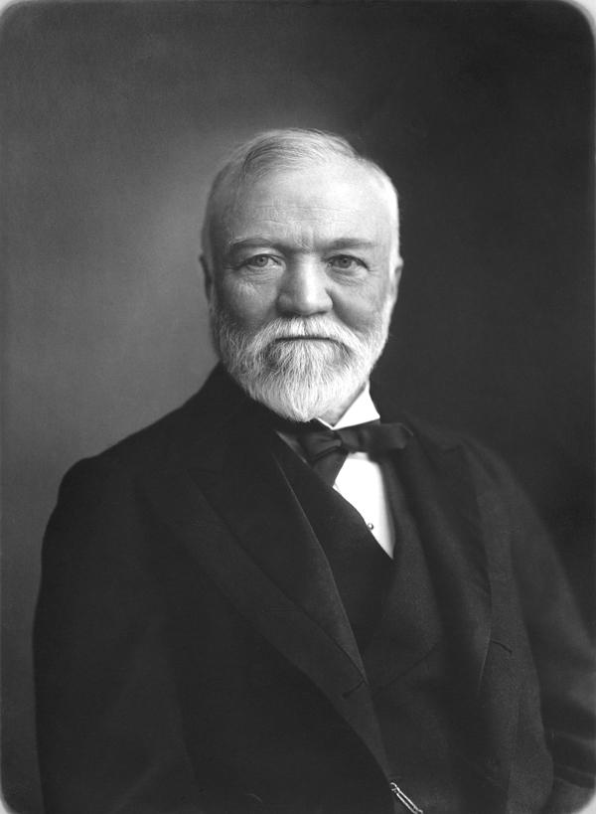
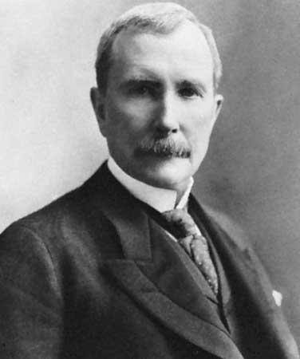
Notable Names
GOOD GUYS
Lincoln Steffens
Wrote an article in McClure’s magazine called “Tweed Days in St. Louis”
Exposed how city officials worked with big business to maintain power while corrupting the public treasury
Ida Tarbell
Wrote a series in McClure’s Magazine called “History of the Standard Oil Company”
Outlines and documented Rockefeller’s cutthroat business tactics
Presidents
Theodore Roosevelt
Woodrow Wilson
BAD GUYS
Andrew Carnegie
Steel empire
Ruthless business tactics
Vertical Integration
John D. Rockefeller
Founded Standard Oil Company
Monopoly on the oil industry
Ruthless business tactics
Horizontal Integration

Slide 6
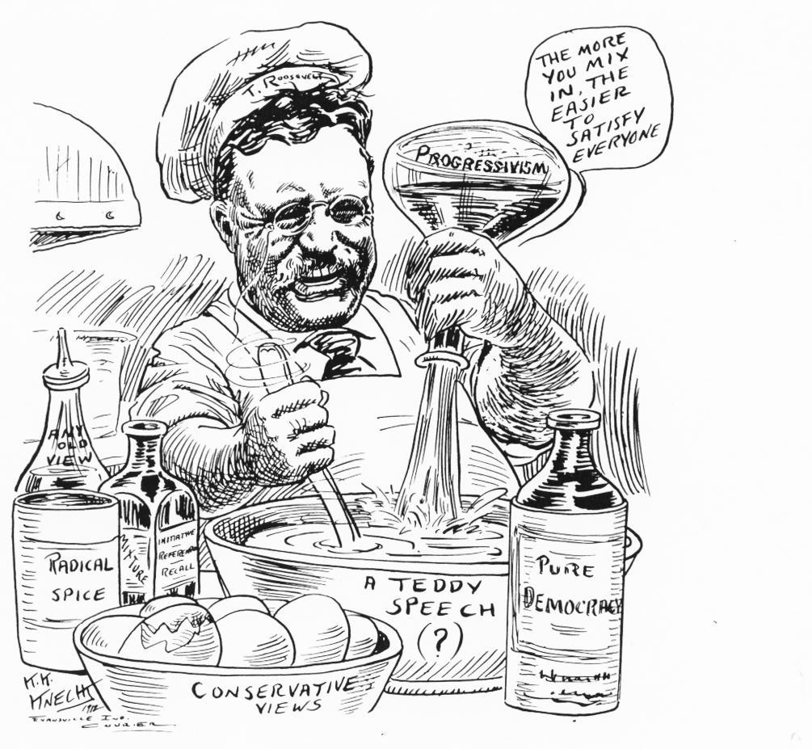
Strategies/Tactics
Presidents enforced laws to watch over large businesses and control monopolies
Making people aware of what is happening in these big businesses
Sherman Antitrust Act- Prevented large firms from controlling a single industry
“Rule of Reason”-Used to interpret Sherman Antitrust Act
Federal Reserve Act-Created central banking system of the United States for better control over money from large businesses

Slide 7
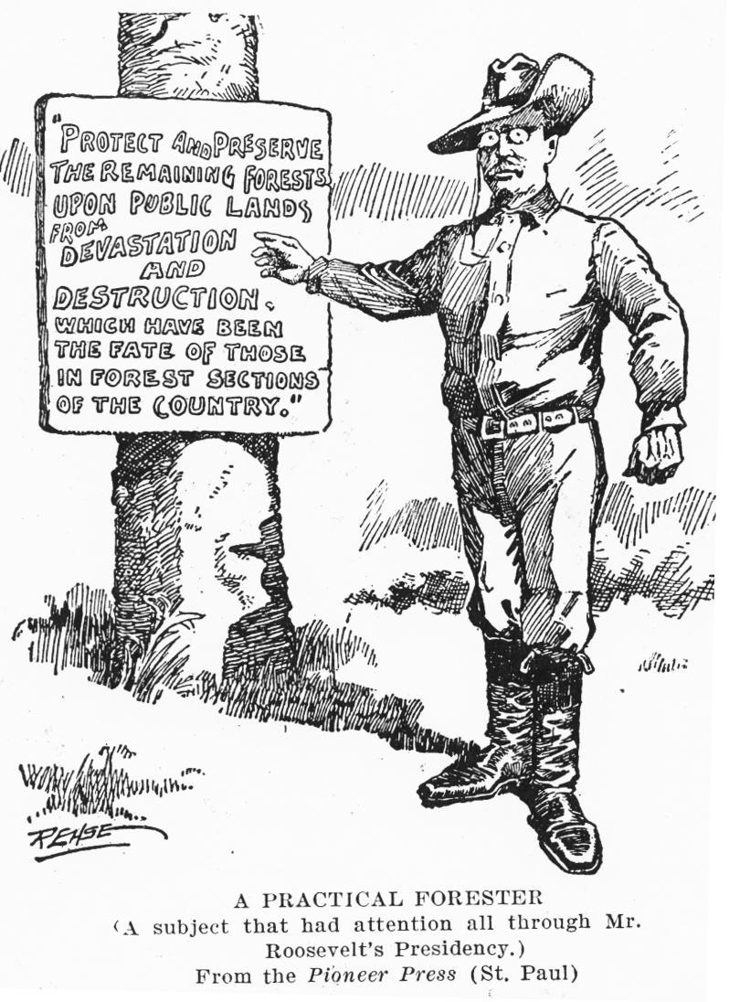
Groups Involved
Republicans
Teddy Roosevelt became president and enforced laws
Formed Progressive Party
William Taft passed the 16th amendment
Democrats
Woodrow Wilson taxed people with large incomes
Labor Unions/Laborers
Better working conditions and wages

Slide 8
Obstacles Faced
Unfairness in markets
Entrepreneurs had more say in government
Difficulty passing legislation
Discrimination & poverty were obstacles against individual freedom & liberty

Slide 9
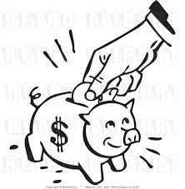
Successes/Failures
Congress enacted law regulating railroads (Interstate Commerce Act 1887)
Election of sympathetic presidents (Roosevelt & Wilson) who enforced these laws
Antitrust Law prohibits monopoly & unfair business practice
Attempted to prevent large firms from controlling a single industry (Sherman Antitrust Act 1890)

